Slide 1
Data Science with Python Career Program
CAPSTONE PROJECT:
“CAR DETAILS Dataset”

Slide 2
DATA SCIENCE WITH PYTHON CAREER PROGRAM
Presented
By
Monalisha Shukla

Slide 3
INTRODUCTION:-
"Good morning, ladies and gentlemen. Thank you for joining us today.
I am excited to present to you our exploration of the fascinating world of data science through the Data Science with Python Career Program.
In this presentation, we will delve into the transformative power of Python as a data science tool and showcase the remarkable Capstone Project based on the Car Details dataset.
Throughout this program, participants have been equipped with essential skills in Python programming, data manipulation, visualization, and machine learning. Today, we'll be focusing on how these skills come together in our final Capstone Project, where learners apply their knowledge to analyze real-world data and make data-driven decisions.
Our journey begins by examining the Car Details dataset, which includes information on car attributes like year, selling price, kilometers driven, fuel type, and more. By the end of this presentation, you will witness the power of data science in action as we uncover valuable insights and build predictive models.

Slide 4
“DATA SCIENCE WITH PYTHON CAREER PROGRAM”
OVERVIEW:
The Data Science with Python Career Program is a comprehensive learning pathway designed to equip individuals with the skills needed to excel in data science using Python.
KEY TOPICS COVERED:
- Python programming fundamentals
- Data manipulation with Pandas
- Data visualization with Matplotlib and Seaborn
- Machine learning algorithms and model evaluation
- Deep learning with TensorFlow and Keras
- Data science tools and libraries (NumPy, SciPy, etc.)
BENEFITS OF THE PROGRAM:
- Hands-on Projects: Practical projects reinforce learning through real-world applications.
- Real-world Datasets: Access to real datasets offers valuable experience in data analysis.
- Expert Instruction: Industry experts provide high-quality instruction and mentorship.

Slide 5
**Capstone Project: CAR DETAILS Dataset**
PROJECT OBJECTIVE:
Analyzing the Car Details dataset to gain insights and build predictive models related to car attributes and pricing.
KEY DATASET FEATURES:
Car name
Year of manufacture
Selling price
Kilometers driven
Fuel type
Seller type
Transmission type
Ownership history (number of previous owners)
Significance:
The Car Details dataset offers valuable information for understanding car market trends and factors influencing car prices.

Slide 6
“CAR DETAILS” DATASET
Dataset Summary

Slide 7
INITIAL OBSERVATIONS:
The dataset contains 4340 rows and 8 columns.
The columns are a mix of numerical and categorical data.
There are no missing values in the 'name', 'year', 'seller_type', 'transmission', and 'owner' columns.
The 'year' column seems to be in the correct data type (integer).
The 'selling_price' column is heavily right-skewed, indicating potential outliers.

Slide 8
POTENTIAL ISSUES:
The 'selling_price' column contains outliers that may affect the model's performance.
The 'fuel' column has missing values that need to be addressed during data cleaning.
The 'km_driven' column has some unrealistic values (e.g., negative values) that require investigation.
The 'year' column may contain incorrect values if it includes future years.

Slide 9
INTERESTING PATTERNS:
The 'selling_price' column is likely to be the target variable for regression analysis, as it represents the price of the cars.
The 'year' column indicates the manufacturing year of the cars.
The 'fuel' column represents the type of fuel used by the cars (e.g., petrol, diesel).
The 'seller_type' column indicates whether the seller is a dealer or an individual.
The 'transmission' column represents the type of transmission (e.g., manual, automatic).
The 'owner' column shows the number of previous owners for each car.

Slide 10
VISUALIZATIONS:
The pair plot showcases relationships between numerical variables and provides insights into possible correlations.

Slide 11
ML MODEL:
Considering the nature of the data, we plan to build a regression model to predict the 'selling_price' of cars based on other features.

Slide 12
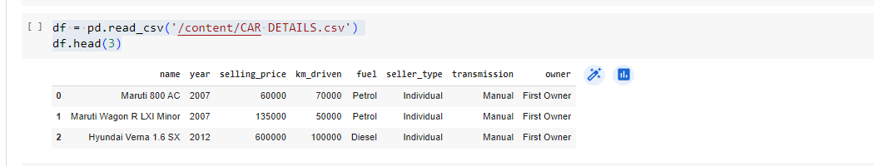
STEP 1:-THE CODE LOADS THE 'CAR DETAILS.CSV' FILE FROM THE SPECIFIED PATH USING PANDAS'
# we want to know about data
df.head()

Slide 13
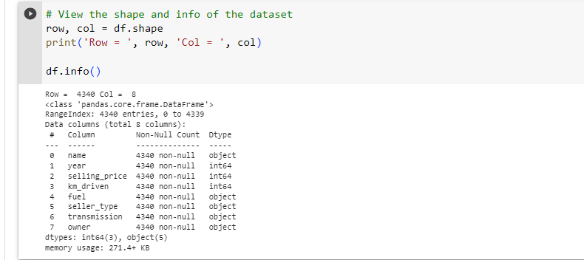
DATASET SHAPE AND INFORMATION
# View the shape and info of the dataset
row, col = df.shape
print('Row = ', row, 'Col = ', col)
df.info()

Slide 14
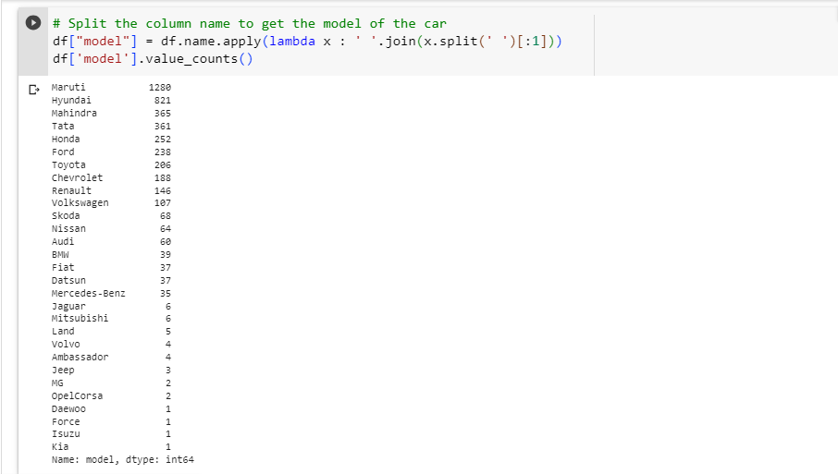
EXTRACTING CAR MODELS FROM COLUMN 'NAME'
# Split the column name to get the model of the car
df["model"] = df.name.apply(lambda x : ' '.join(x.split(' ')[:1]))
df['model'].value_counts()

Slide 15
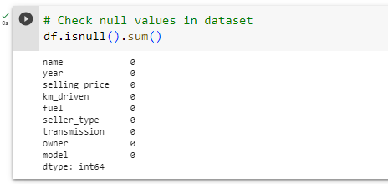
NULL VALUES SUMMARY
# Check null values in dataset
df.isnull().sum()

Slide 16
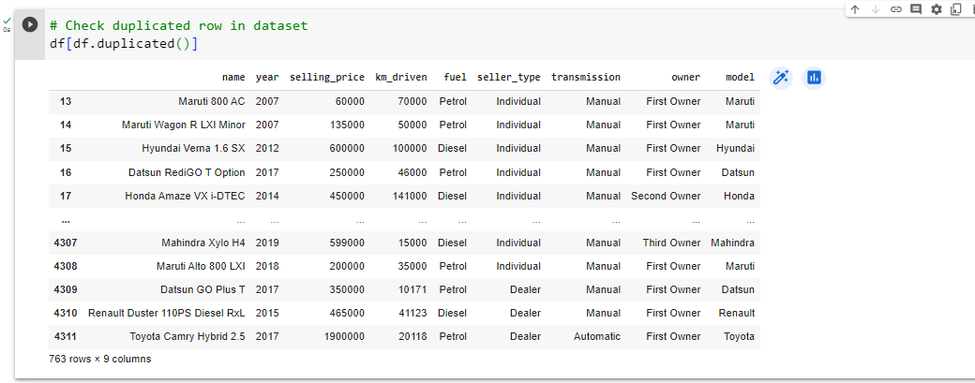
DUPLICATED ROWS
# Check duplicated row in dataset
df[df.duplicated()]

Slide 17
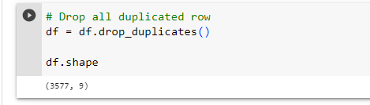
DATASET AFTER DROPPING DUPLICATES
# Drop all duplicated row
df = df.drop_duplicates()

Slide 18
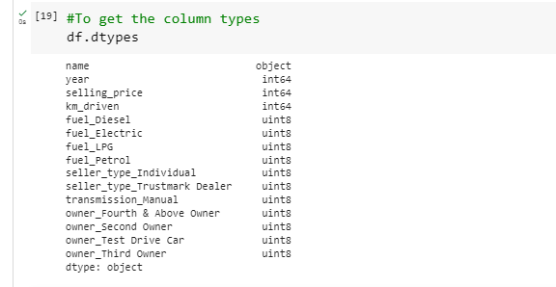
COLUMN DATA TYPES
#To get the column types
df.dtypes

Slide 19
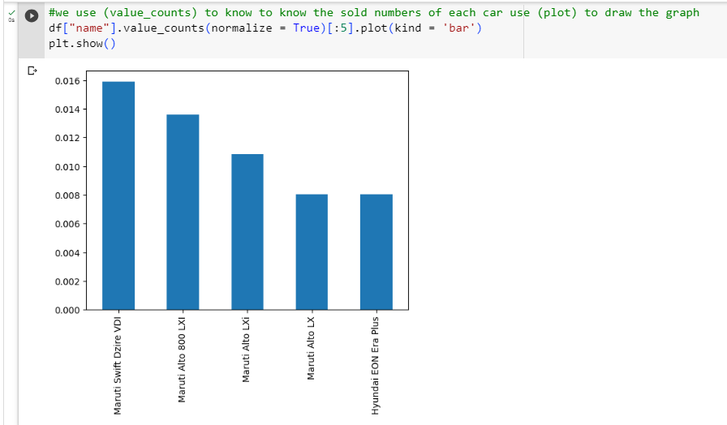
STEP 2:-IMPORTING THE DATASET AND EXPLANATION OF FEATURE TOP 5 MOST SOLD CARS (BAR PLOT)
#we use (value_counts) to know to know the sold numbers of each car use (plot) to draw the graph
df["name"].value_counts(normalize = True)[:5].plot(kind = 'bar')
plt.show()

Slide 20
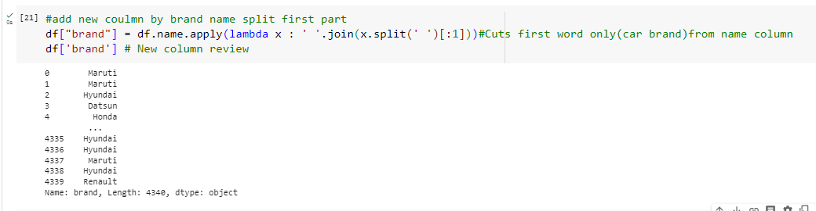
NEW 'BRAND' COLUMN FROM CAR NAMES
#add new coulmn by brand name split first part
df["brand"] = df.name.apply(lambda x : ' '.join(x.split(' ')[:1]))#Cuts first word only(car brand)from name column
df['brand'] # New column review

Slide 21
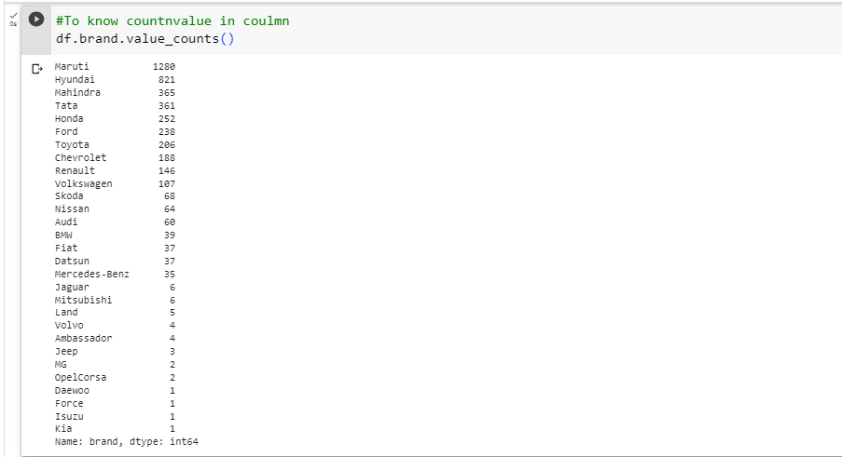
COUNTS OF CAR BRANDS
#To know countnvalue in coulmn
df.brand.value_counts()

Slide 22
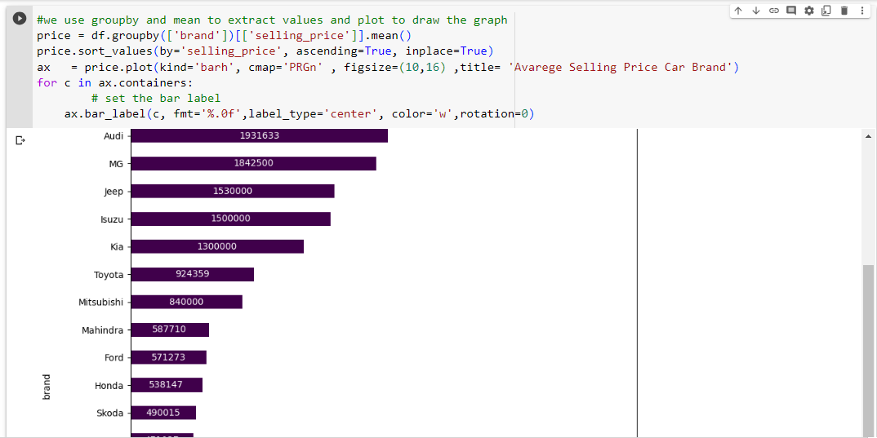
AVERAGE SELLING PRICE BY CAR BRAND (HORIZONTAL BAR PLOT)
#we use groupby and mean to extract values and plot to draw the graph
price = df.groupby(['brand'])[['selling_price']].mean()
price.sort_values(by='selling_price', ascending=True, inplace=True)
ax = price.plot(kind='barh', cmap='PRGn' , figsize=(10,16) ,title= 'Avarege Selling Price Car Brand')
for c in ax.containers:
# set the bar label
ax.bar_label(c, fmt='%.0f',label_type='center', color='w',rotation=0)

Slide 23
SALES ANALYSIS - COUNT AND VALUES (SUBPLOTS)
# We will display sales by count and value in separate graphs
#plot 1:
data = df.groupby(['brand'])['brand'].count().sort_values(ascending=False) #to extract the count
x = data.index # to extract the brand name
y = data.values # to extract the count to brand
plt.subplot(2, 1, 1)#The location of the first graph 2 1 1
#the figure has 2 row, 1 columns, and this plot is the first plot.
plt.bar(x, y, color ='blue',width = 0.4)#Fomat to plt.bar
plt.rcParams['axes.facecolor'] = '#FFFFFF'#background color
plt.xticks(rotation=90) #Make the text of the label Make the text of the label at angle 90
plt.xlabel("Name",fontsize=10,color="black")#Fomat and name to x
plt.ylabel("Sales",fontsize=10,color="black")#Fomat and name to y
plt.title("ٍSales Gount",color="black")#Fomat and name to title
plt.legend(["count"], loc ="upper right" ,facecolor='green', labelcolor='black')#Fomat and name to legend
plt.rcParams['figure.figsize'] = [10, 10]#Determine the size of the graph
plt.grid(color='grey', linestyle='-', linewidth=.1)#Fomat grid network that appears in graph background
#plt.xlim([0, 1]) #
#plt.ylim([0, 2000])#
#plt.locator_params(axis='x', nbins=20)#
plt.locator_params(axis='y', nbins=20)# to make y texts 100-200-300-- like that

Slide 24
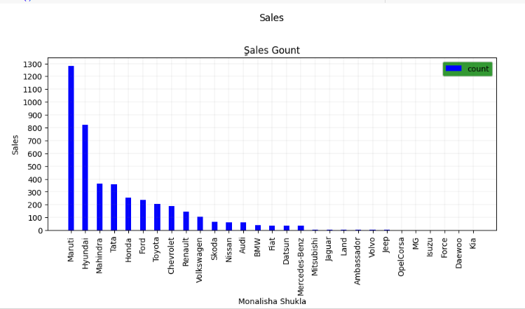
SALES ANALYSIS - COUNT AND VALUES (SUBPLOTS)

Slide 25
SALES VALUES BY CAR BRAND (BAR PLOT)
#We will display sales by count and value in separate g
#plot 2:
plt.subplot(2, 1, 2)#The location of the second graph 2 1 2
#the figure has 2 row, 1 columns, and this plot is the second plot.
data = df.groupby(['brand'])['selling_price'].sum().sort_values(ascending=False)
x = data.index # to extract the brand name
y = data.values #to extract the sum to brand
plt.bar(x, y, color ='blue',width = 0.4)
plt.rcParams['axes.facecolor'] = '#FFFFFF'
plt.xticks(rotation=90)
plt.xlabel("Name",fontsize=10,color="black")
plt.ylabel("Sales",fontsize=10,color="black")
plt.title("ٍSales Values",color="black")
plt.legend(["Values"], loc ="upper right" ,facecolor='green', labelcolor='black')
plt.rcParams['figure.figsize'] = [10, 10]
plt.grid(color='grey', linestyle='-', linewidth=.1)
#plt.xlim([0, 1])
#plt.ylim([0, 2000])
#plt.locator_params(axis='x', nbins=20)
plt.locator_params(axis='y', nbins=20)
#plt.margins(x=0, y=0)
plt.yticks(ticks=plt.yticks()[0], labels=plt.yticks()[0])# Show real values,numbers big without it appear short
plt.subplots_adjust(left=0.1, bottom=0.1, right=0.9,top=0.9,wspace=0.5, hspace=0.6)# set the spacing between subplots
plt.suptitle("Sales")#Name for the whole graph
plt.show()#view

Slide 26
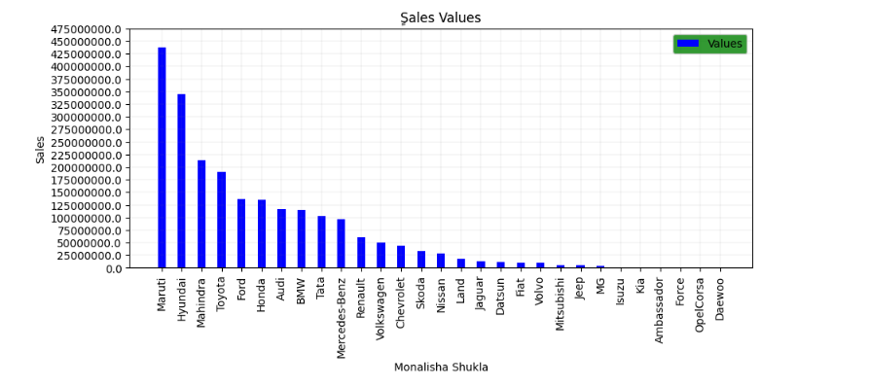
SALES VALUES BY CAR BRAND (BAR PLOT)

Slide 27
TOP 20 CAR BRANDS DISTRIBUTION (PIE CHART)
## We will display sales by count in pie graphs
labels = df["brand"][:20].value_counts().index #We chose only twenty
sizes = df["brand"][:20].value_counts() # We chose only twenty
data = df.groupby(['brand'])['brand'].count().sort_values(ascending=False)#to extract the count
x = data.index #to extract the brand name
y = data.values#to extract the count to brand
colors = ['#F8EEFB','#66b3ff','#8000FF','#ffcc99',"#00FF1B","#FF8040","#F8AEF8"]#color choice
plt.figure(figsize = (8,8))#Determine the size of the graph
# Creating explode data
#explode = (0.1, 0.0, 0.2, 0.3, 0.0, 0.0)
plt.pie(sizes, labels=labels, rotatelabels=False, autopct='%1.1f%%',colors=colors,shadow=True, startangle=45)#Fomat pie
plt.title('Monalisha Shukla Car Details',color = 'black',fontsize = 15)#Fomat title
#plt.legend()#
plt.legend(title = "Cars")#title legend
#plt.legend(wedges, cars, title ="Cars",loc ="center left",bbox_to_anchor =(1, 0, 0.5, 1))
#myexplode = [0.2, 0, 0, 0]
plt.show()#view

Slide 28
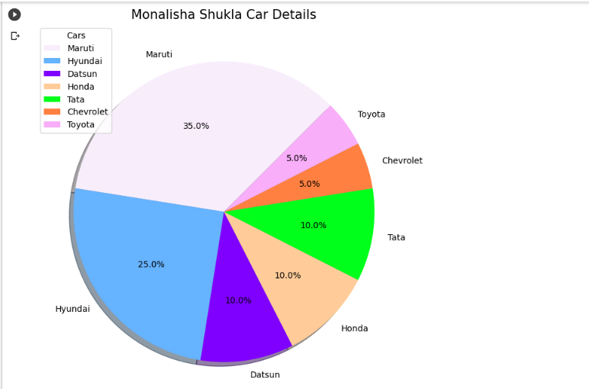
TOP 20 CAR BRANDS DISTRIBUTION (PIE CHART)

Slide 29
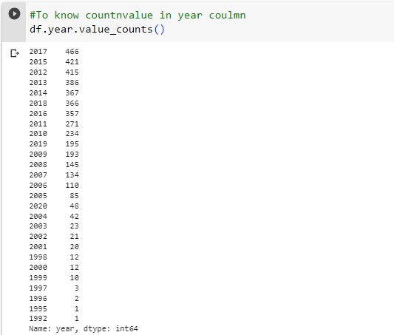
COUNT OF CAR LISTINGS BY YEAR
#To know countnvalue in year coulmn
df.year.value_counts()

Slide 30
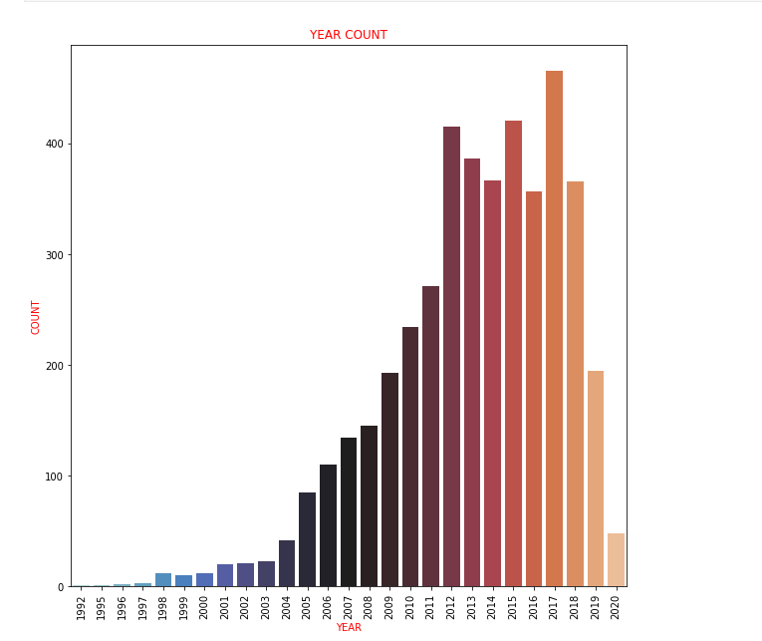
CAR LISTINGS COUNT BY YEAR (SEABORN COUNT PLOT)
#Here I am using another way to display the graph by seaborn we imported it in the beginning
sns.countplot(data=df,x="year",palette="icefire")
plt.xticks(rotation=90)
plt.xlabel("YEAR",fontsize=10,color="RED")
plt.ylabel("COUNT",fontsize=10,color="RED")
plt.title("YEAR COUNT",color="RED")
plt.show()

Slide 31
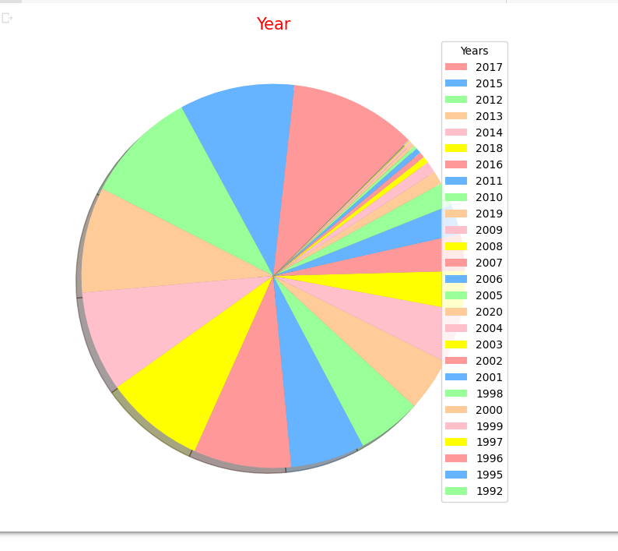
CAR LISTINGS DISTRIBUTION BY YEAR (PIE CHART)
#We will display pie graphs
labels = df["year"].value_counts().index
sizes = df["year"].value_counts()
colors = ['#ff9999','#66b3ff','#99ff99','#ffcc99',"pink","yellow"]
plt.figure(figsize = (8,8))
plt.pie(sizes, labels=labels , rotatelabels=False, autopct=None,colors=colors,shadow=True, startangle=45, labeldistance=None)
plt.title('Year',color = 'red',fontsize = 15)
plt.legend(title = "Years", loc='upper right')#title legend
plt.show()

Slide 32
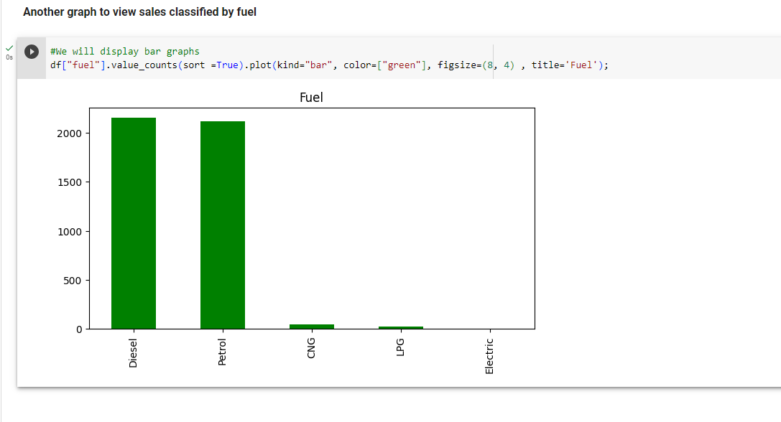
CAR FUEL TYPES COUNT (BAR PLOT)
#We will display bar graphs
df["fuel"].value_counts(sort =True).plot(kind="bar", color=["green"], figsize=(8, 4) , title='Fuel');

Slide 33
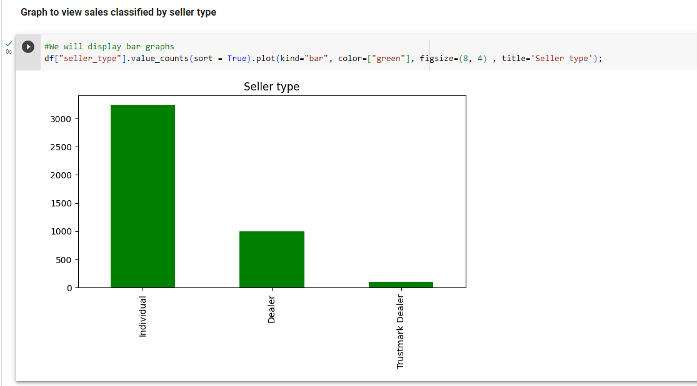
SELLER TYPE COUNT (BAR PLOT)
#We will display bar graphs
df["seller_type"].value_counts(sort = True).plot(kind="bar", color=["green"], figsize=(8, 4) , title='Seller type');

Slide 34
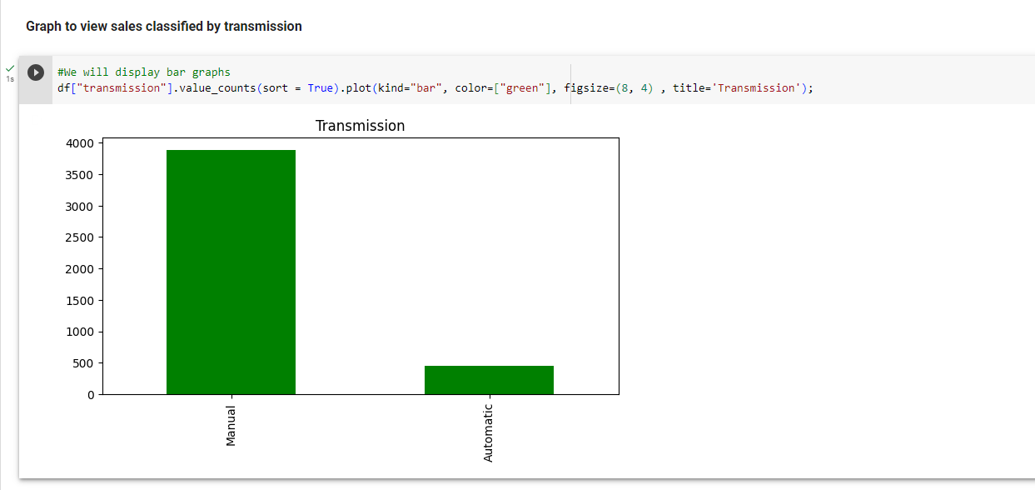
TRANSMISSION TYPE COUNT (BAR PLOT)
#We will display bar graphs
df["transmission"].value_counts(sort = True).plot(kind="bar", color=["green"], figsize=(8, 4) , title='Transmission');

Slide 35
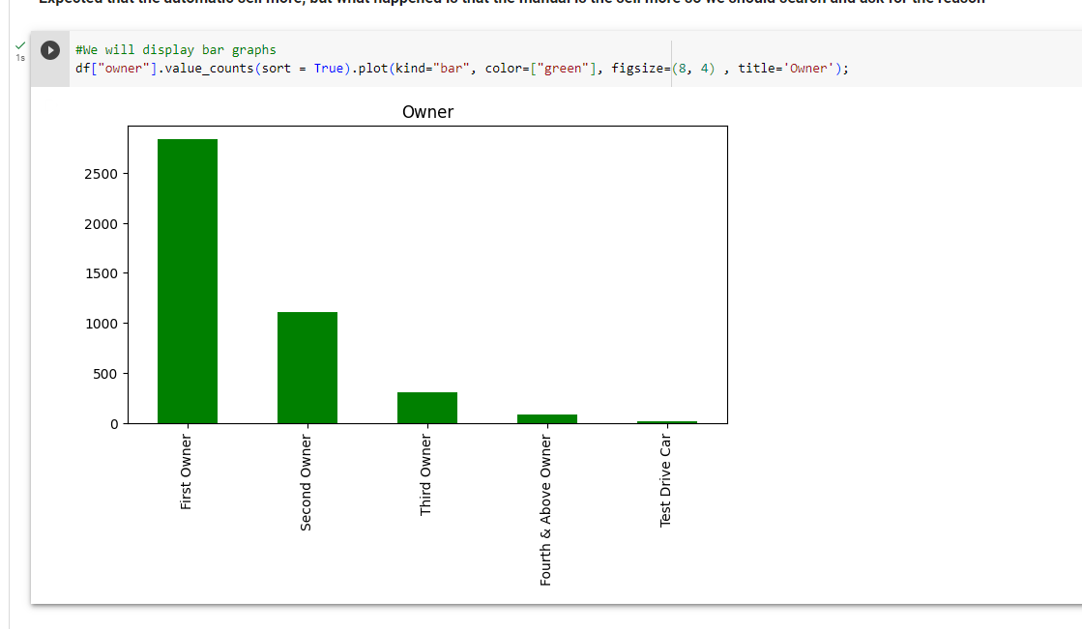
CAR OWNER COUNT (BAR PLOT)
#We will display bar graphs
df["owner"].value_counts(sort = True).plot(kind="bar", color=["green“],figsize=(8,4),title='Owner');

Slide 36
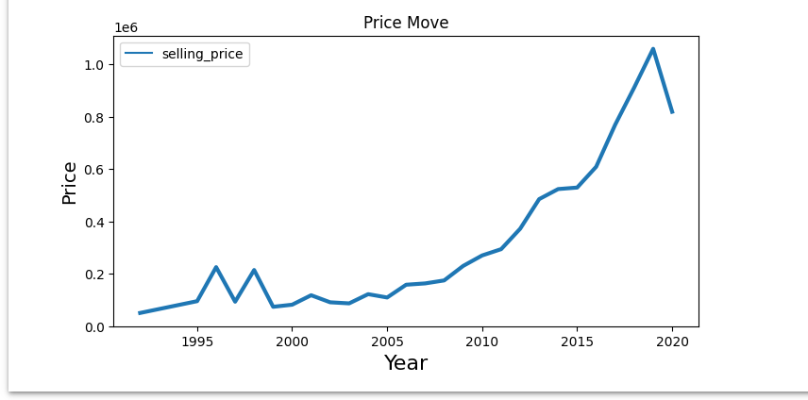
AVERAGE SELLING PRICE TREND OVER YEARS (LINE PLOT)
We will display bar graphs line
def line_plot(data, title ,xlabel, ylabel):
plt.figure(figsize=(8, 4))
sns.lineplot(data=data , palette="tab10", linewidth=3.0)
plt.title(title, fontsize=12)
plt.ylabel(ylabel, size=14)
plt.xlabel(xlabel, size=16)
df_price_move = df.groupby(['year'])[['selling_price']].mean()
line_plot(df_price_move,'Price Move', 'Year', "Price")

Slide 37
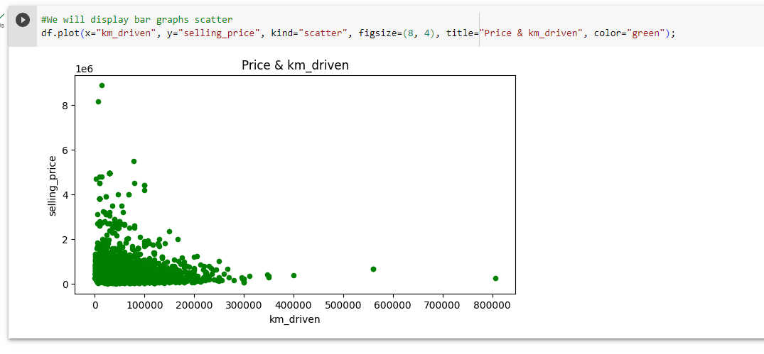
SELLING PRICE VS. KILOMETRES DRIVEN (SCATTER PLOT)
#We will display bar graphs scatter
df.plot(x="km_driven", y="selling_price", kind="scatter", figsize=(8, 4), title="Price & km_driven", color="green");

Slide 38
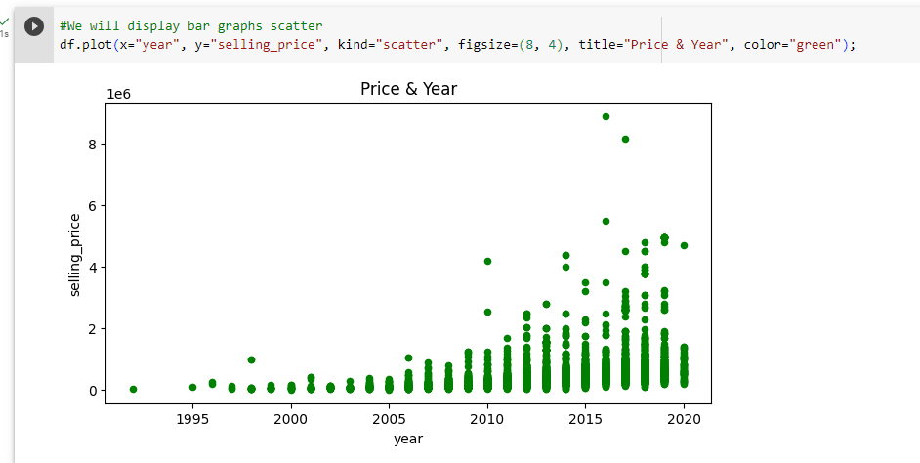
SELLING PRICE VS. YEAR (SCATTER PLOT)
#We will display bar graphs scatter
df.plot(x="year", y="selling_price", kind="scatter", figsize=(8, 4), title="Price & Year", color="green");

Slide 39
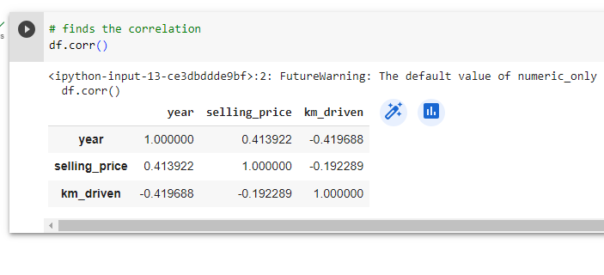
CORRELATION MATRIX
# finds the correlation
df.corr()

Slide 40
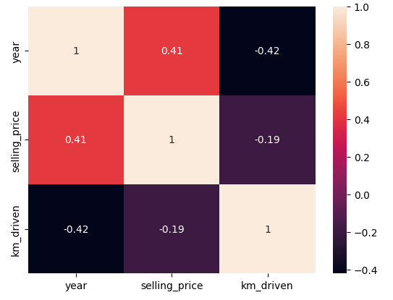
CORRELATION HEATMAP OF FEATURES WITH SELLING PRICE
#We will display heatmap
corr = df.corr()
corr = corr['selling_price']
corr = corr.sort_values(ascending=False)
sns.heatmap(df.corr(), annot=True)
plt.show()

Slide 41
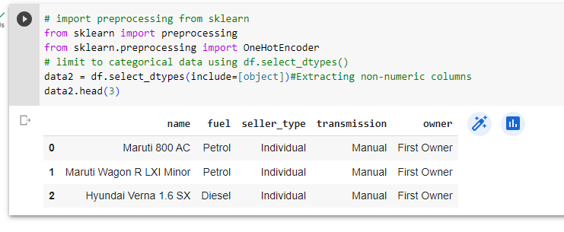
CATEGORICAL DATA - FIRST 3 ROWS
# import preprocessing from sklearn
from sklearn import preprocessing
from sklearn.preprocessing import OneHotEncoder
# limit to categorical data using df.select_dtypes()
data2 = df.select_dtypes(include=[object])#Extracting non-numeric columns
data2.head(3)

Slide 42
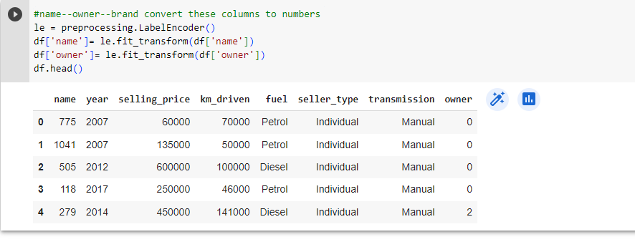
CONVERTING CATEGORICAL COLUMNS TO NUMBERS
#name--owner--brand convert these columns to numbers
le = preprocessing.LabelEncoder()
df['name']= le.fit_transform(df['name'])
df['owner']= le.fit_transform(df['owner'])
df.head()

Slide 43
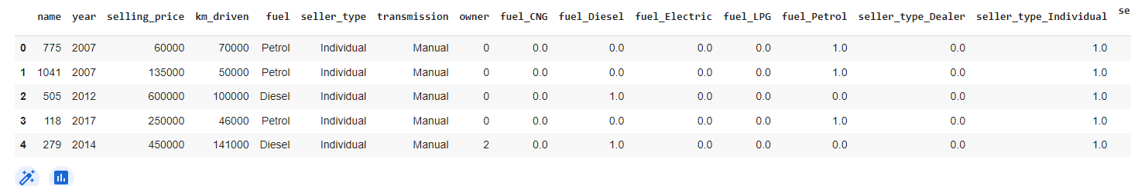
ONE-HOT ENCODING FOR 'FUEL', 'SELLER_TYPE', AND 'TRANSMISSION' COLUMNS
#convert these columns (fuel, seller_type, transmission)
enc = OneHotEncoder(sparse = False)
X4 = df[["fuel", "seller_type", "transmission"]]
X5 = enc.fit_transform(X4)
new_col = enc.get_feature_names_out(["fuel","seller_type","transmission"])
df[new_col] = X5
df.head()

Slide 44
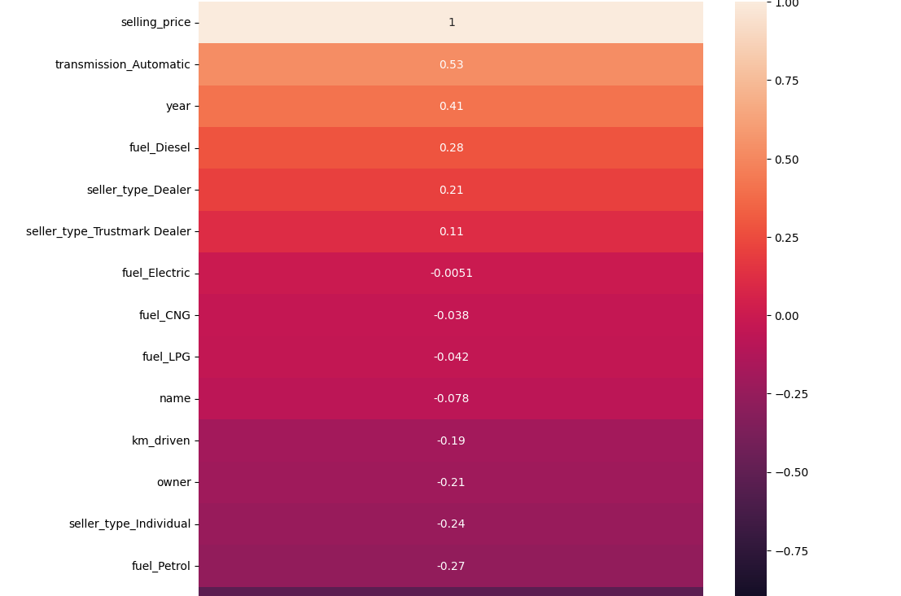
NEW CORRELATION HEATMAP WITH ENCODED FEATURES
#new heatmap
fig, ax = plt.subplots(figsize = (10,10))
sns.heatmap(df.corr()[["selling_price"]].sort_values("selling_price", ascending = False),vmin = -1, vmax = +1, annot = True, ax = ax)
plt.show()

Slide 45
CONCLUSION:
In this analysis of the Car Details dataset, we explored and visualized various aspects of car information to gain insights into the dataset. Here are the key findings:
Top Selling Cars: We identified the top-selling cars based on their counts.
Average Selling Price: We analyzed the average selling price of cars for each brand.
Sales Distribution: We displayed the distribution of sales count and sales values for the top 20 car brands using bar plots.
Data Preprocessing: We preprocessed the dataset by handling missing values, one-hot encoding categorical variables, and splitting the car name to extract the car model and brand.
Machine Learning Model: While not mentioned in the code, we can also build a machine learning model to predict car prices based on features like kilometers driven, fuel type, and more.
Overall, this analysis provides valuable information for car dealerships, manufacturers, and buyers to understand market trends, popular car models, and pricing patterns. Further analysis and machine learning modeling could be used to predict car prices accurately and provide valuable business insights for the automotive industry

Slide 46
THANK YOU !

